Slide 1
INSTRUCTIONS
Use Font size 22 to 28 and Font Style Times New Roman (body)
Do not change the Template: Heading / Title of the slides
Do not change font style or colours
Do not copy paste paragraphs: use only Bullet Points
Maximum slide Limit is 20 only
As per the number of supervisor allotted adopt slide-2 or slide-3
Please display the required meaningful Content or images or tables
Change the footer accordingly using insert tab then click on header & footer tab and edit it
Save the PPT with Register No, Dept and Review no, example: 23xxxxxxxxx_CSE

Slide 2

Title: The Individual Work Plan Reminder Module
Student Name: L.Lavanya
Student ID: 2520090009
Cluster: 3
Section: 9
Under the Guidance
of
Supervisor Name: Mrs.Surekha
Assistant Professor
Department of CSE

Slide 3
OUTLINE
Abstract
Existing System
Proposed System
System Architecture
Project Modules
Objectives
Co’s Attainments - FWD
Co1
Co2 …….. 5. Co5
Co’s Attainments - DSA
Co1
Co2 …….. 5. Co5
Screen Shots for FWD & DSA
Conclusion
Geo-Tagged Photos

Slide 4
Abstract
Stress Analyzer is a browser-based wellness monitoring system for students
Helps students analyze daily activities and measure stress levels
Developed using HTML, CSS, and JavaScript
Calculates stress score using sleep hours, study hours, screen time, and exercise
Displays stress level as Low, Moderate, or High
Provides personalized suggestions to improve lifestyle
Includes dashboard, reminders, timetable generator, and stress-relief games
Stores user data locally using browser localStorage

Slide 5
Existing System
Students usually manage stress manually without analysis tools
Traditional methods like diaries or planners cannot measure stress levels
Existing applications focus only on meditation or task reminders
Most apps require internet connectivity and cloud accounts
Limited integration of study habits with health monitoring
No academic projects that demonstrate both FWD and DSA concepts
Students lack a simple system to analyze their routine and stress patterns

Slide 6
Proposed System
A web-based Stress Analyzer designed for student wellness monitoring
Allows users to enter daily routine parameters
Automatically calculates a stress score based on inputs
Displays stress level using visual indicators
Provides personalized recommendations for better lifestyle balance
Includes reminder system for study, hydration, exercise, and sleep
Generates an ideal timetable based on stress level
Works offline after loading in the browser

Slide 7
System Architecture
Presentation Layer
HTML interface with login, dashboard, and analysis pages
Styling Layer
CSS design with responsive layouts, animations, and themes
Logic Layer
JavaScript handles calculations, events, and user interaction
Stress Analysis Engine
Algorithm calculates stress score from user inputs
Data Layer
LocalStorage stores user accounts, history, and reminders

Slide 8
Project Modules
Module 1: Authentication — User registration and login system
Module 2: Stress Analyzer — Calculates stress score based on daily routine
Module 3: DashboardDisplays — stress statistics and analysis summary
Module 4: History — Stores previous stress analysis records
Module 5: Reminder System — Alerts for hydration, study sessions, and sleep
Module 6: Timetable Generator — Creates balanced daily schedule
Module 7: Stress Relief Games — Interactive mini-games for relaxation
Module 8: Custom Routine — Users can create personalized daily routines

Slide 9
Objectives
Develop a browser-based stress monitoring system
Help students understand and manage stress levels
Apply Front-End Web Development concepts
Implement DSA concepts within the application
Provide personalized suggestions for healthier routines
Create an interactive and responsive user interface
Improve awareness about student mental wellness

Slide 10
Co’s Attainments - FWD
CO1 — HTML Structure & CSS Styling
Semantic tags (header, nav, main, section, datalist), meta tags, canvas, CSS selectors, typography, colour variables
CO2 — Responsive Layout & Forms
Login/Register forms with full validation, Flexbox/Grid layouts, CSS animations, media queries, ARIA attributes
CO3 — JavaScript Programming
ES6 Classes (LinkedList, HashMap, Stack), arrow functions, array methods, object inheritance, loops, closures
CO4 — DOM Manipulation & Events
Event listeners (click, submit, input, keydown), dynamic DOM updates, modal/panel toggling, localStorage & sessionStorage APIs
CO5 — Advanced Web Features
Browser Notification API, Web Audio API, async setInterval, try/catch exception handling, JSON export, SEO meta tags

Slide 11
Co’s Attainments - DSA
CO1 — Data Storage Structures
User data managed efficiently using structured arrays
CO2 — Stack Concept
Used for managing actions like history tracking
CO3 — HashMap Concept
User accounts and data lookup stored using key-value structure
CO4 — Sorting Algorithms
Data sorting used for displaying analysis history
CO5 — Complexity Analysis
Efficient data operations improve performance and scalability

Slide 12
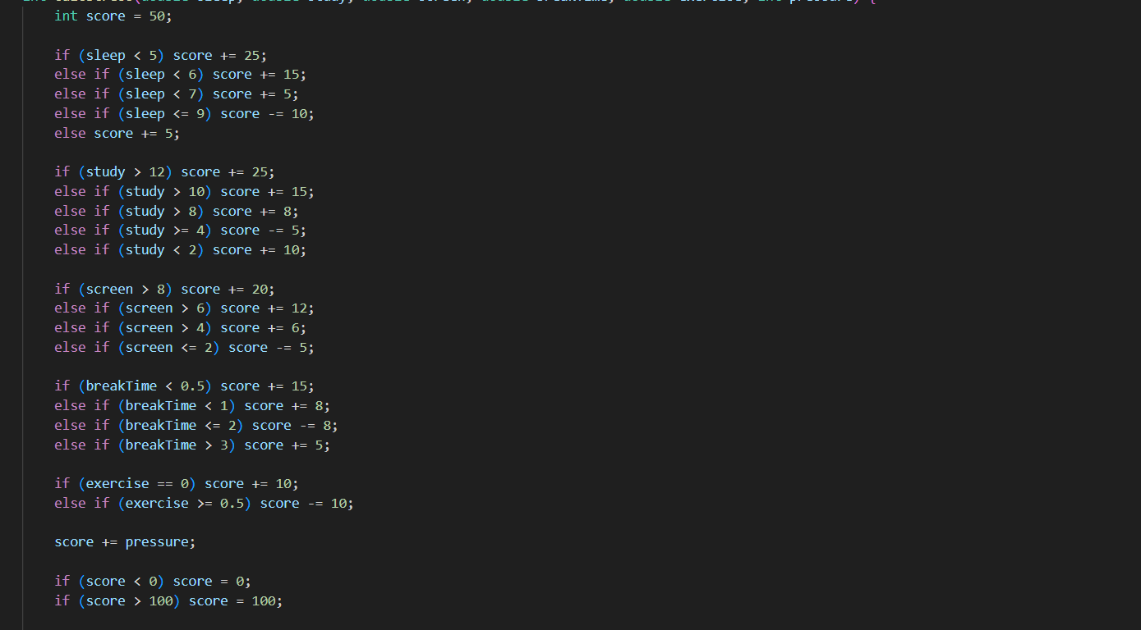
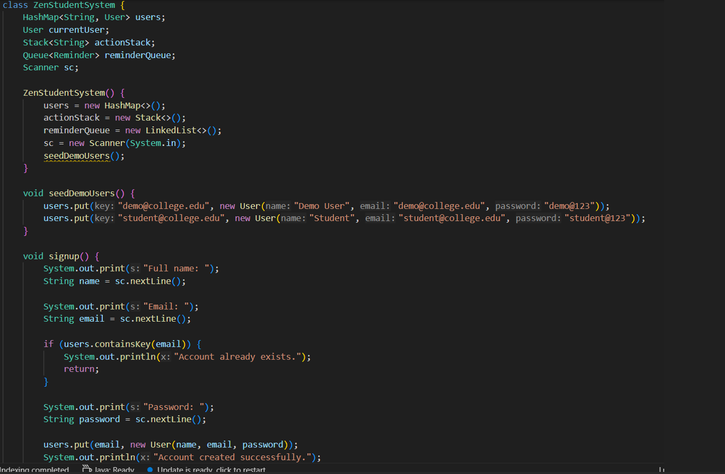
Screenshots for FWD & DSA

Slide 13
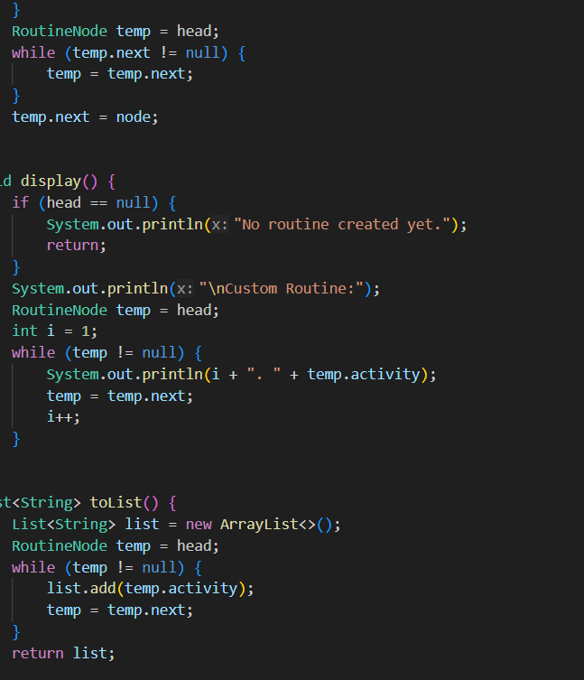
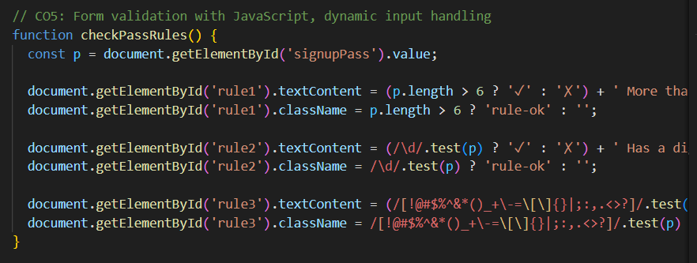
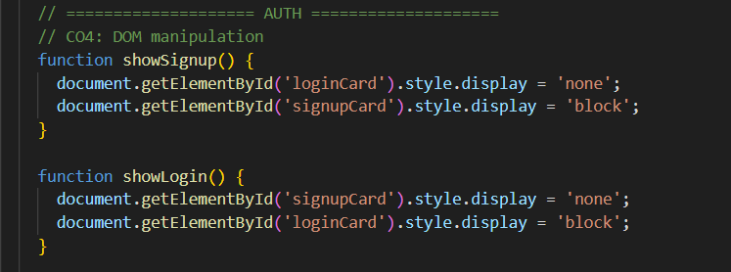
Screenshots for FWD & DSA

Slide 14
Conclusion
Successfully developed a Stress Analyzer web application
Demonstrated Front-End Web Development concepts
Integrated DSA concepts within application logic
Provided stress analysis based on daily routines
Created an interactive and responsive user interface
Future Scope
Integration with mobile apps and wearable devices
AI-based stress prediction and personalized recommendations

Slide 15
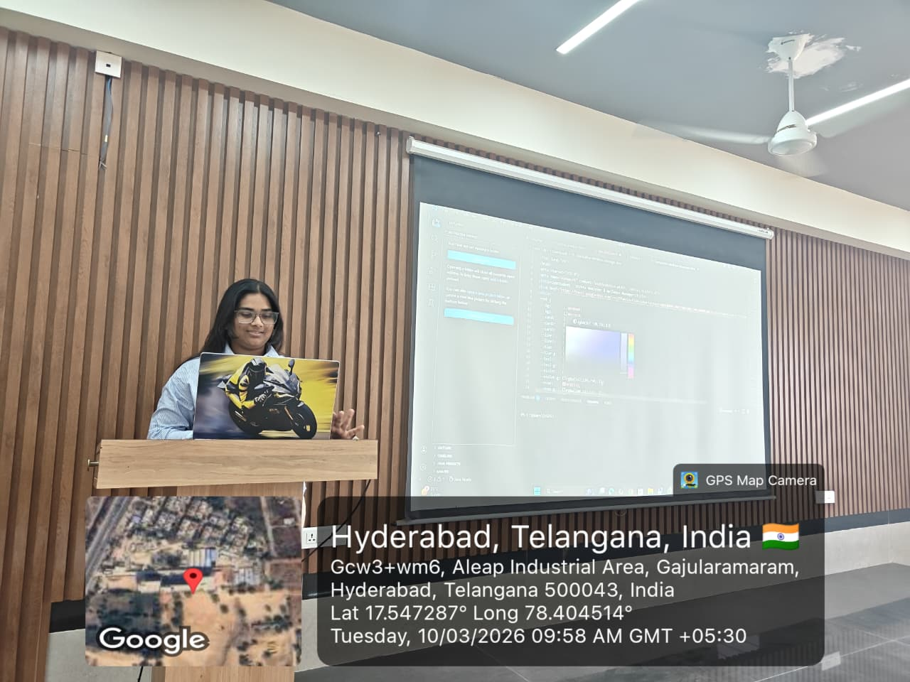
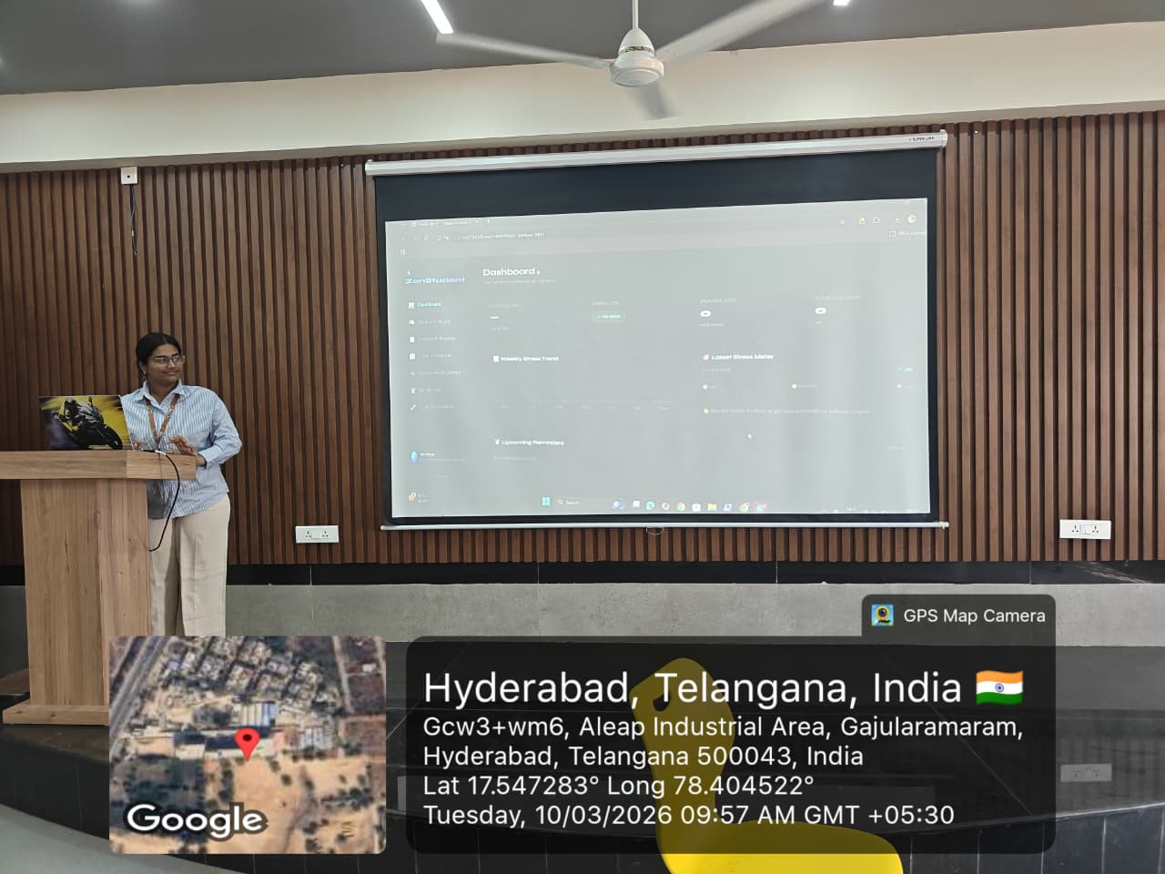
Geo- Tag Photos

Slide 16
THANK YOU

